Slide 1


Test Automation
Team: SAZAM

Slide 2
SoapUI
SoapUI tool is used to test SOAP(Simple Object Access Protocol) and REST(Representational State Transfers).
Project Environment
OS: Windows
Tool: SOAP UI
Programming Language: Groovy Script.

Slide 3
AUT - Features
Add Employee Details: This feature enables the user to enter the information of the employees.
Get Employee Details: This feature displays the details of the employee which are entered.
Delete Employee Details: This feature enables the user to delete the information of the employee.

Slide 4
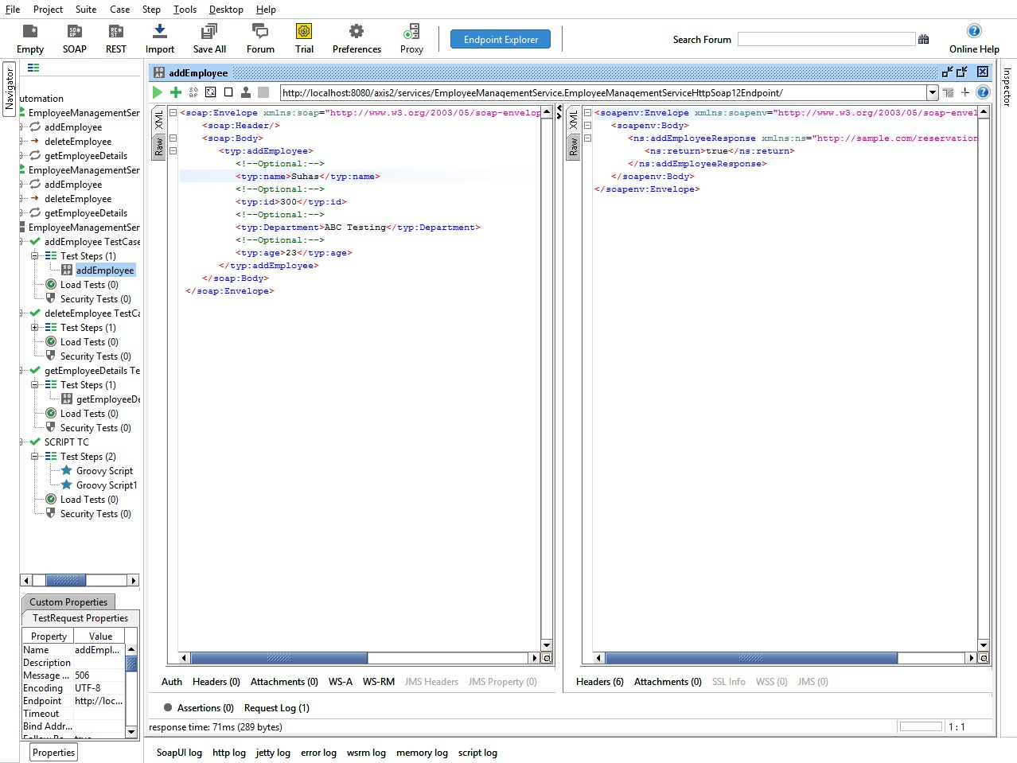
Manual Testing- Add Employee

Slide 5
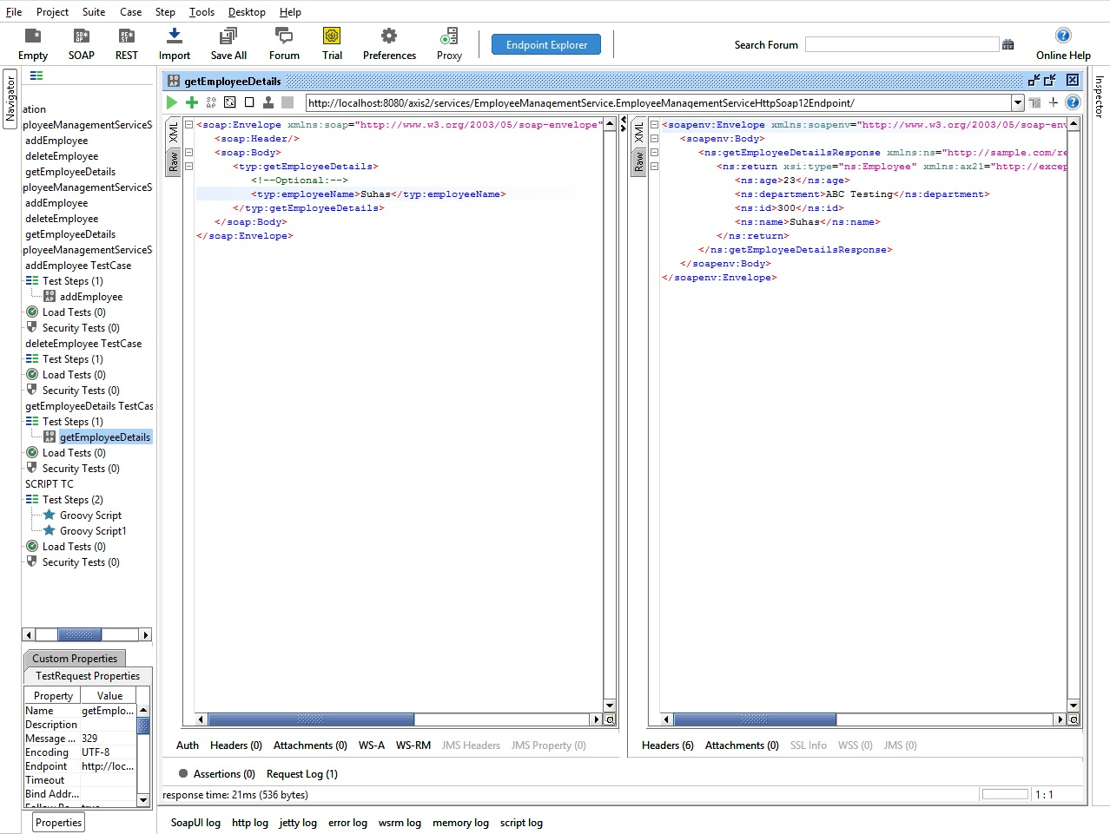
Manual Testing- Get Employee

Slide 6
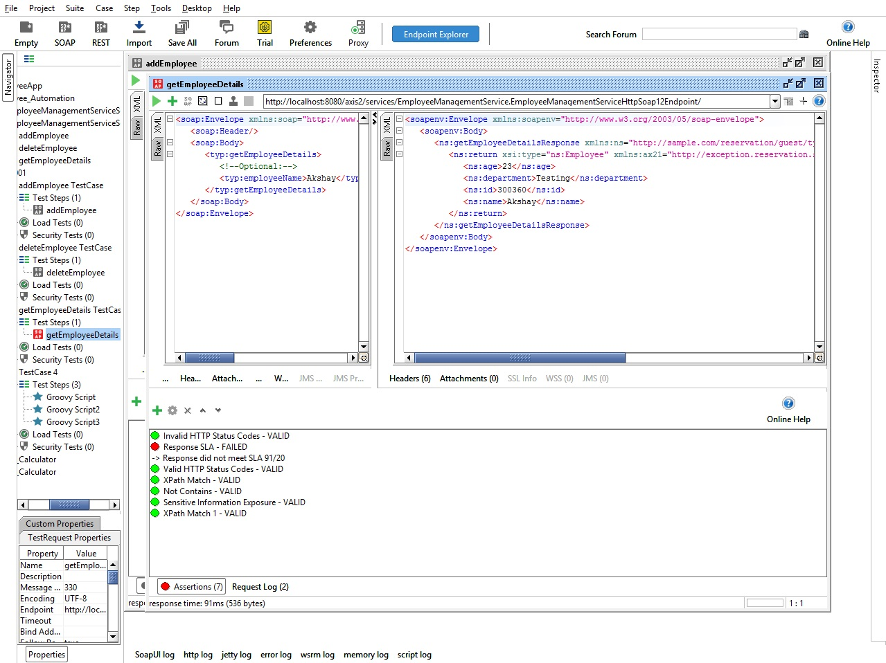
Manual Testing- Assertions
List of Assertions

Slide 7
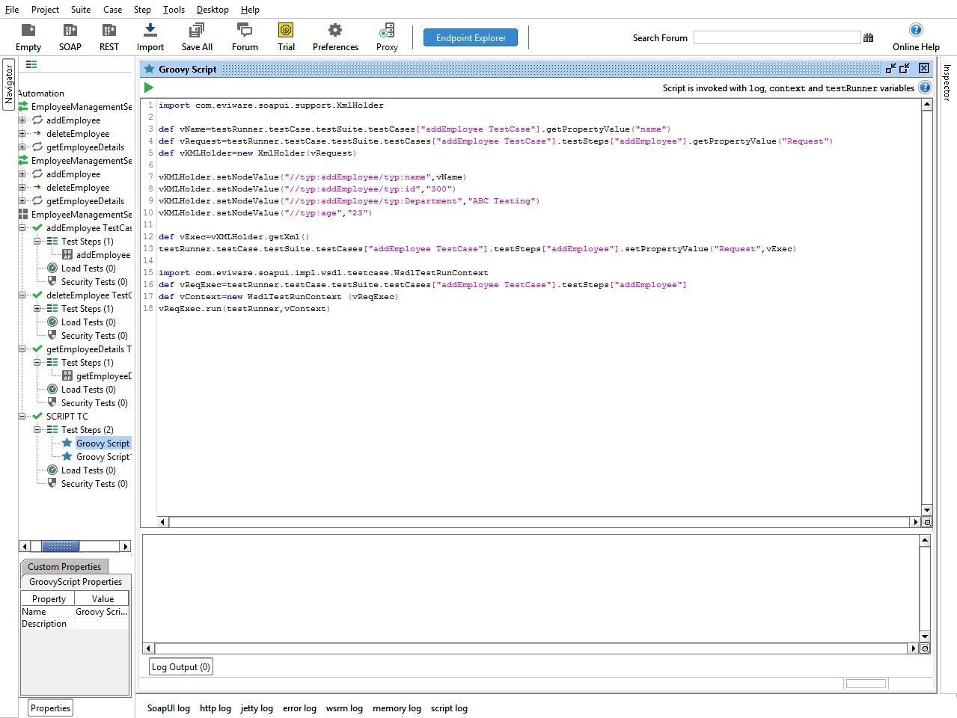
Automation Testing- Add Employee

Slide 8
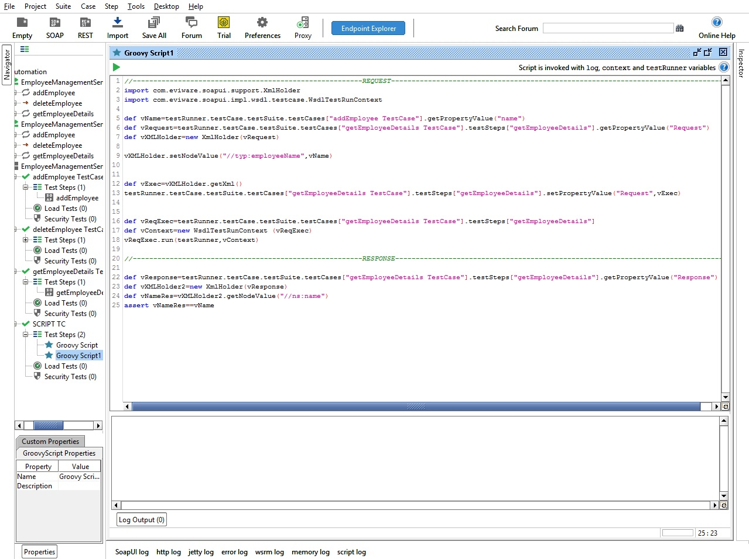
Automation Testing- Get Employee

Slide 9
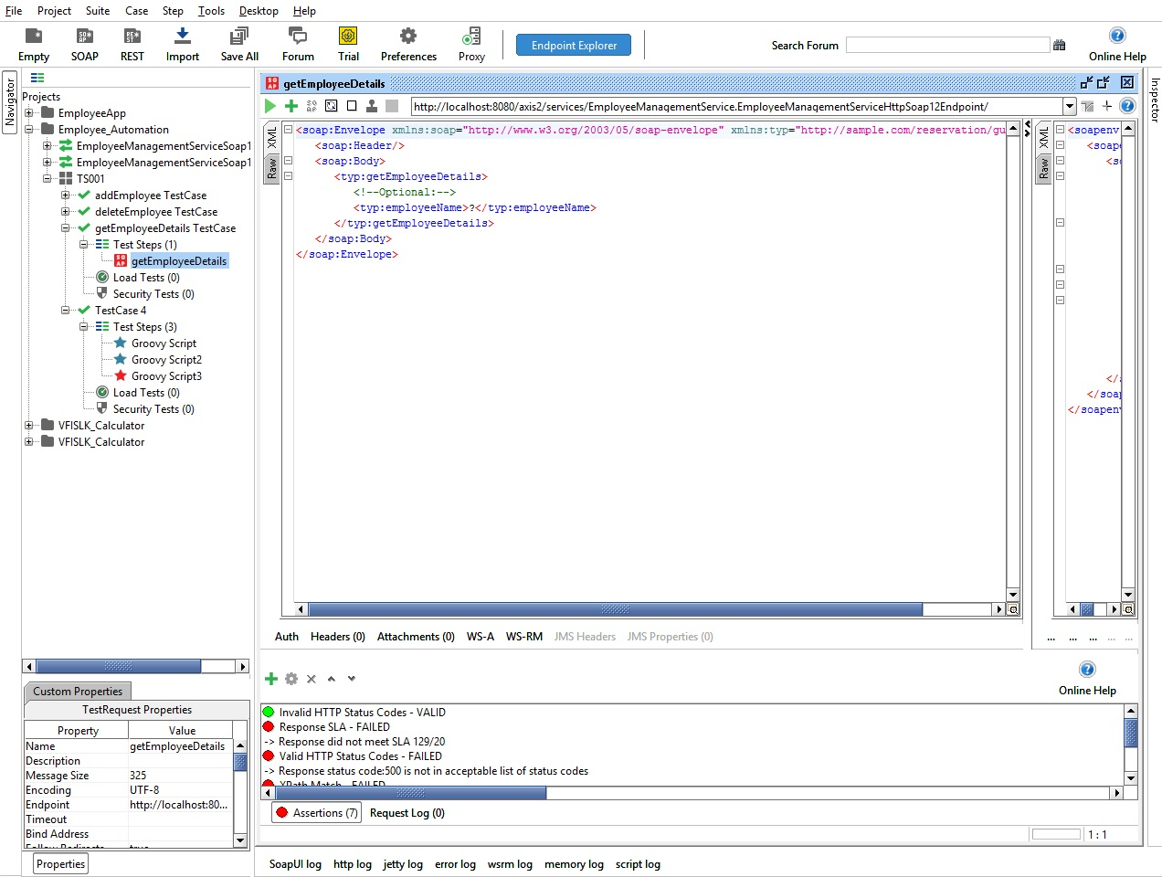
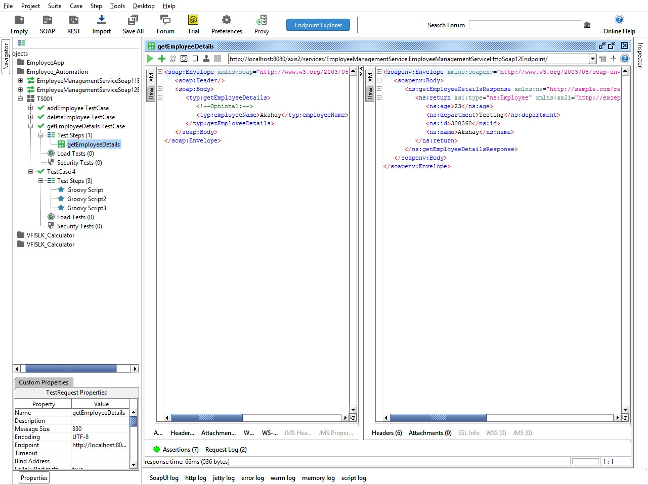
Automation Testing- Get Employee-Test Case Result
Before Execution
After Execution

Slide 10
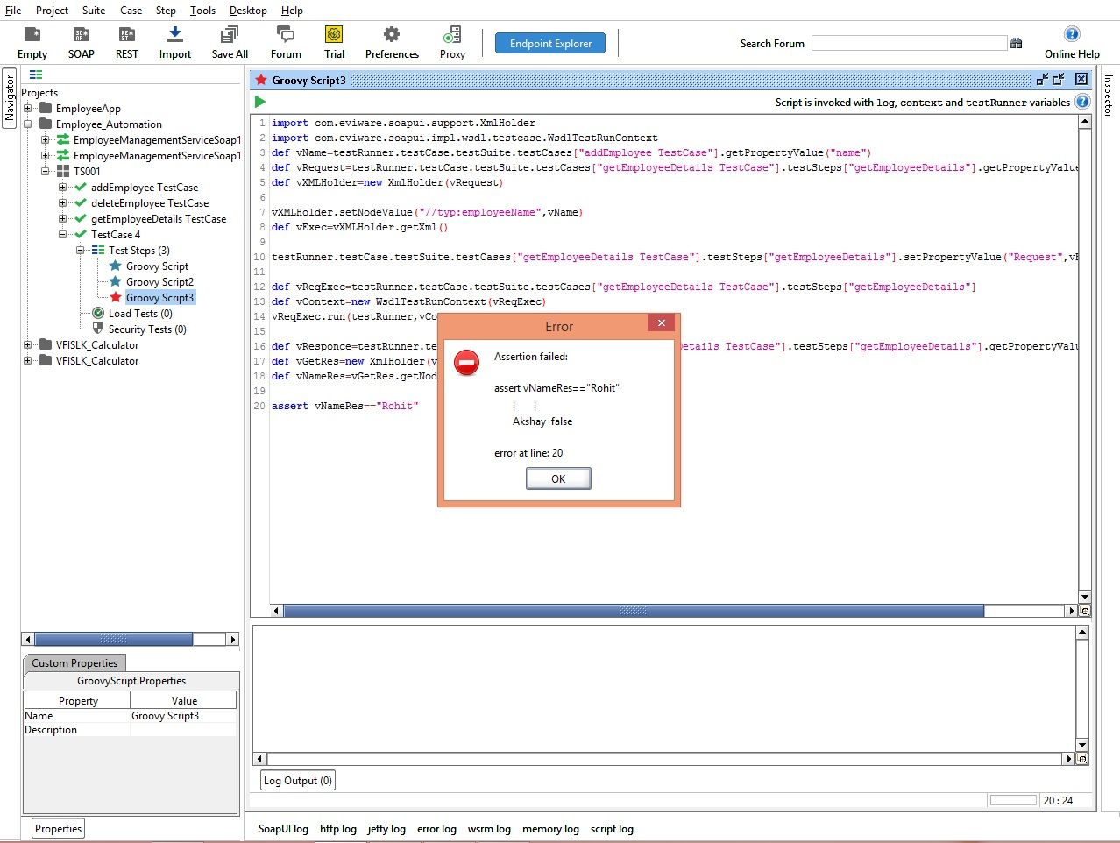
Automation Testing- Get Employee-Test Case Result
Test Case Fail

Slide 11
Selenium
Selenium is a portable framework for testing web applications. Selenium provides a playback tool for authoring functional tests without the need to learn a test scripting language.
Project Environment
OS: Windows
Tool: Selenium
Programming Language: JAVA

Slide 12
AUT - Employee Management System
AUT - Features to be Tested:
Sign Up
Login
Add Employee
View Employee
Edit Employee
Search Employee

Slide 13
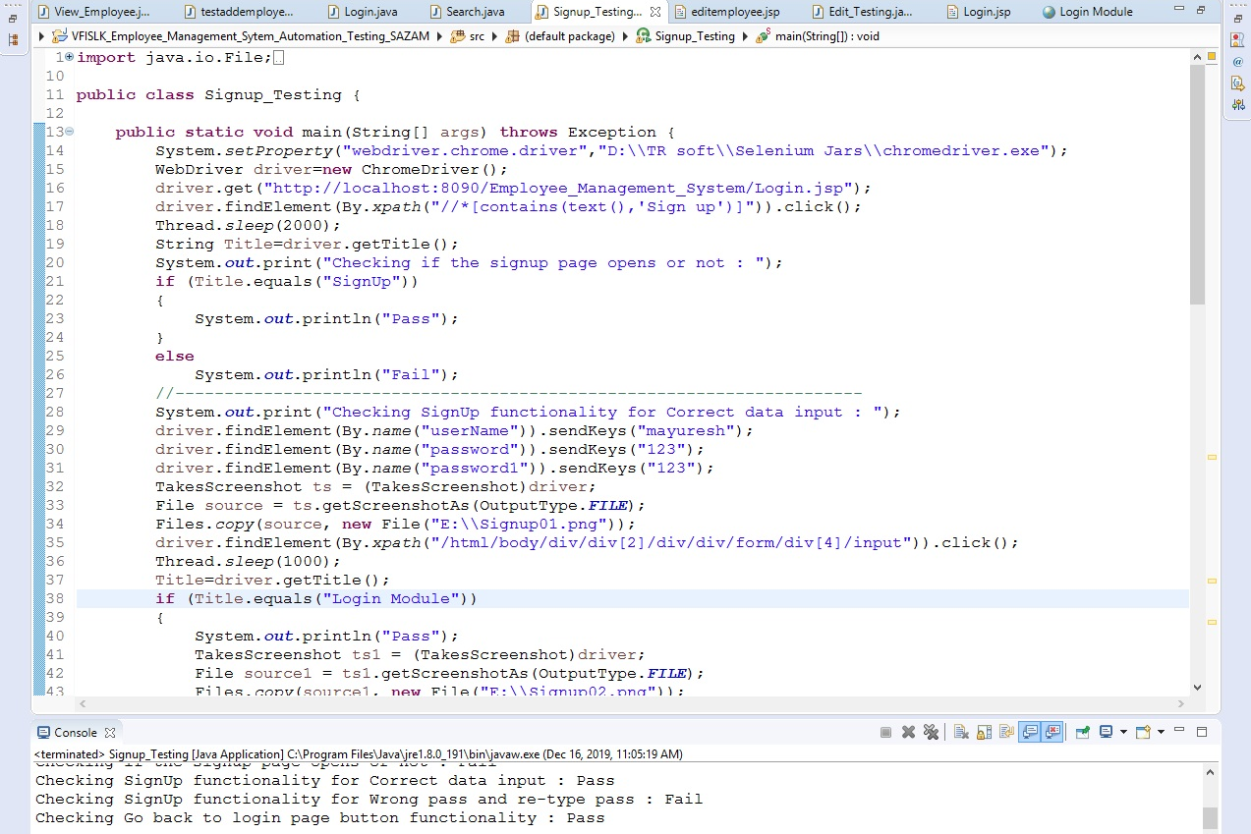
Sign Up– Sample Script
Sign Up page enables the user to register into the system.

Slide 14
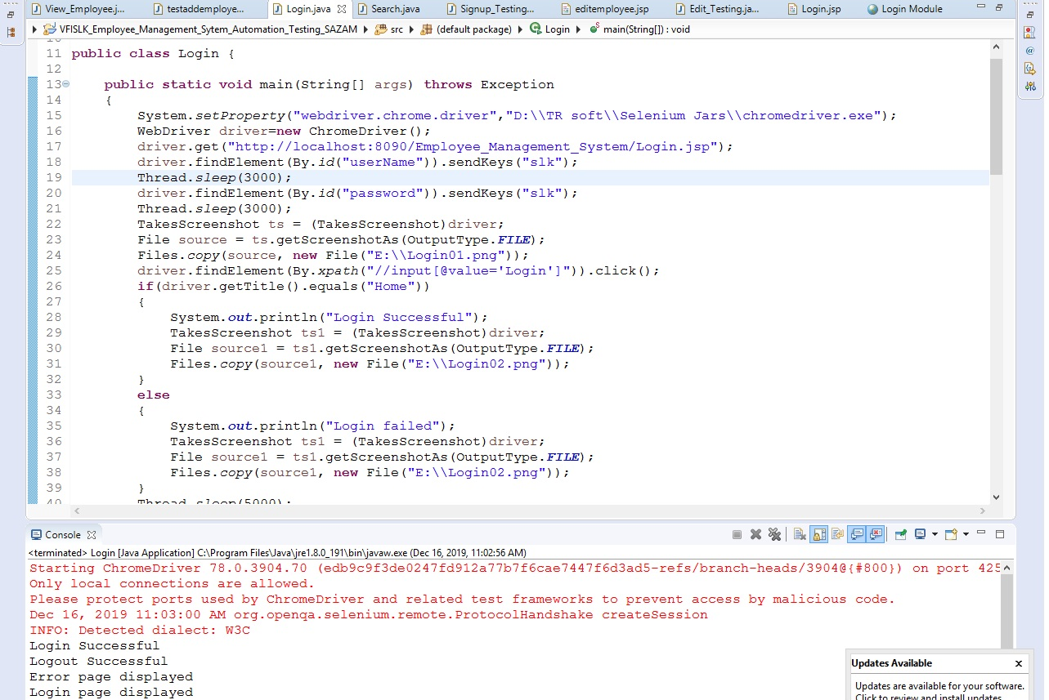
Login– Sample Script
Login page enables the user to Login into the system.

Slide 15
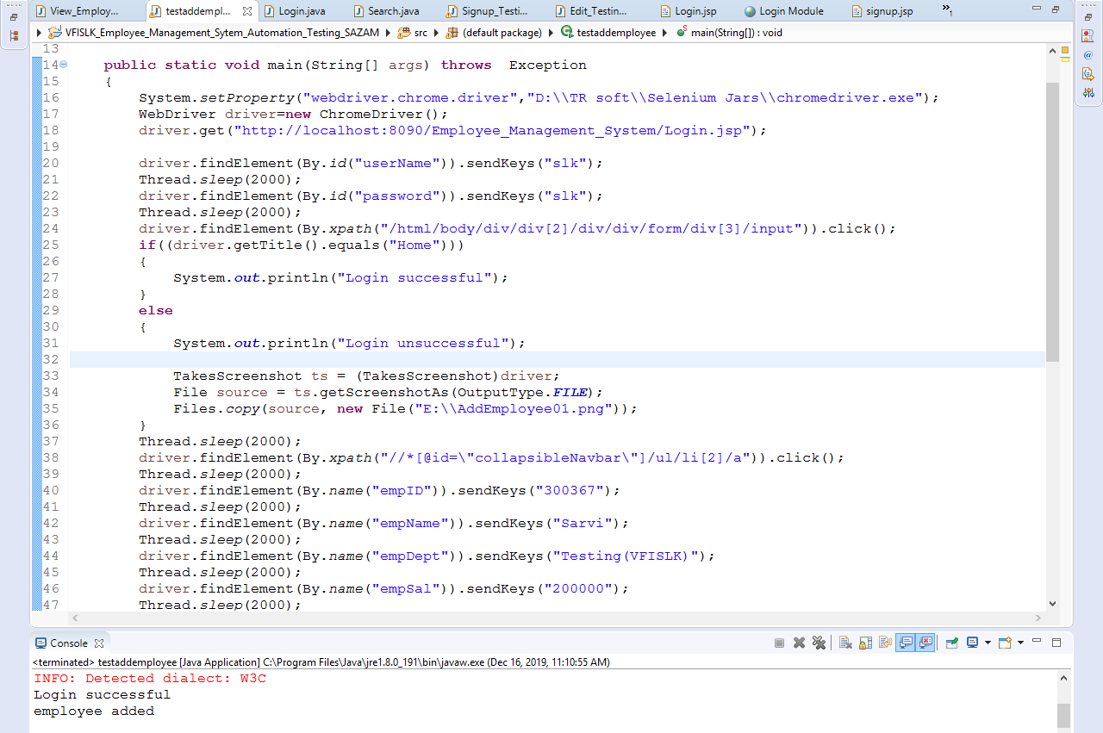
Add Employee– Sample Script
Add employee enables the user to add a new employee to the system.

Slide 16
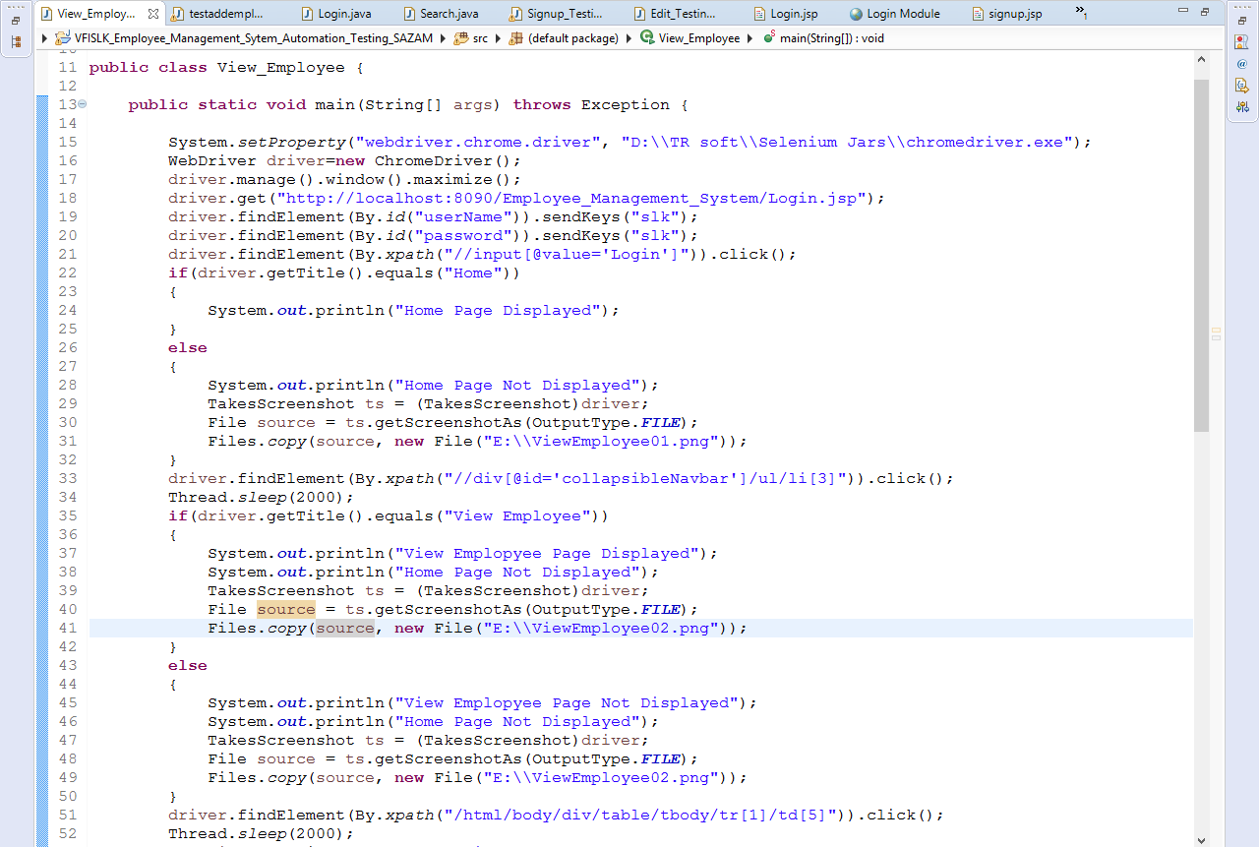
View Employee– Sample Script
View Employee page enables the user to view the list of registered employees in the system.

Slide 17
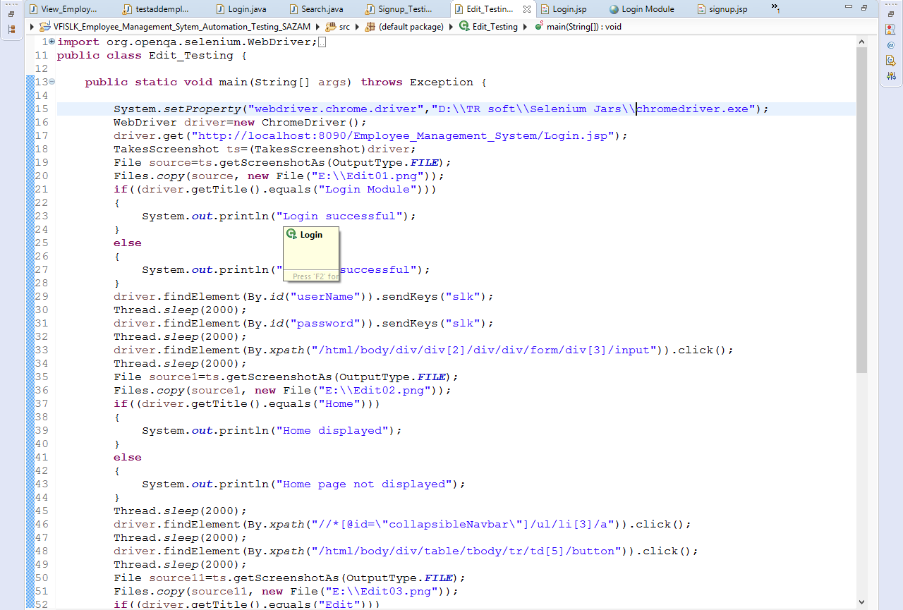
Edit Employee– Sample Script
Edit Employee page enables the user to edit employee details from the registered employees in the system.

Slide 18
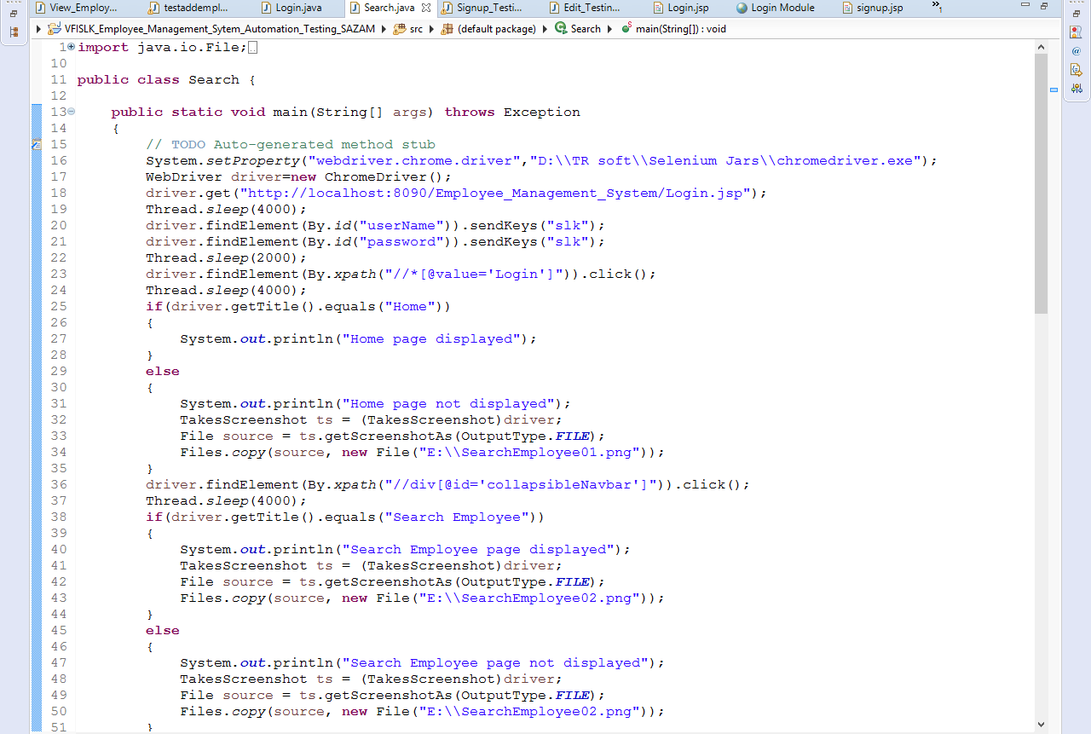
Search Employee– Sample Script
Search Employee page enables the user to search the registered employees in the system.

Slide 19
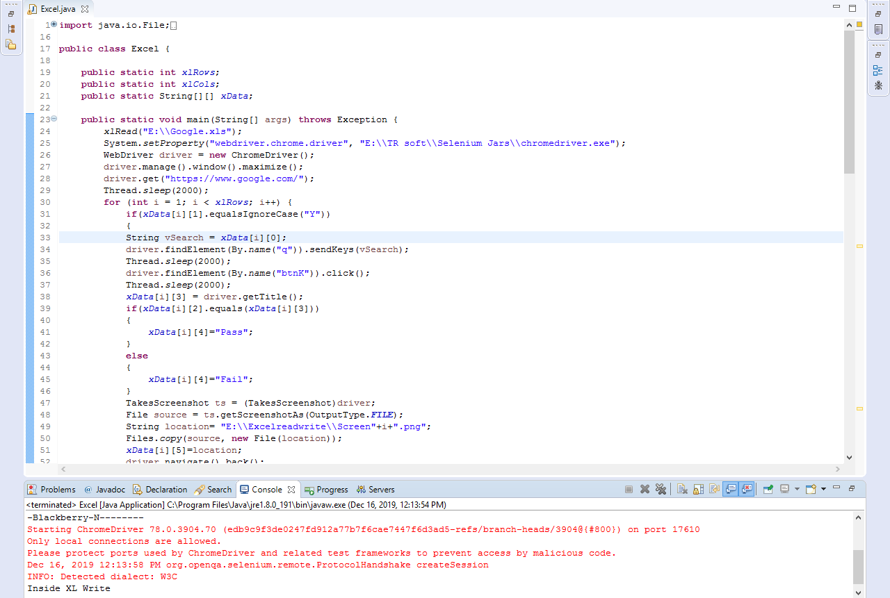
Google Search – Case Study 1
Retrieving the data from the Excel sheet, searching it in Google and updating the status & screen shot location in the Excel sheet.

Slide 20
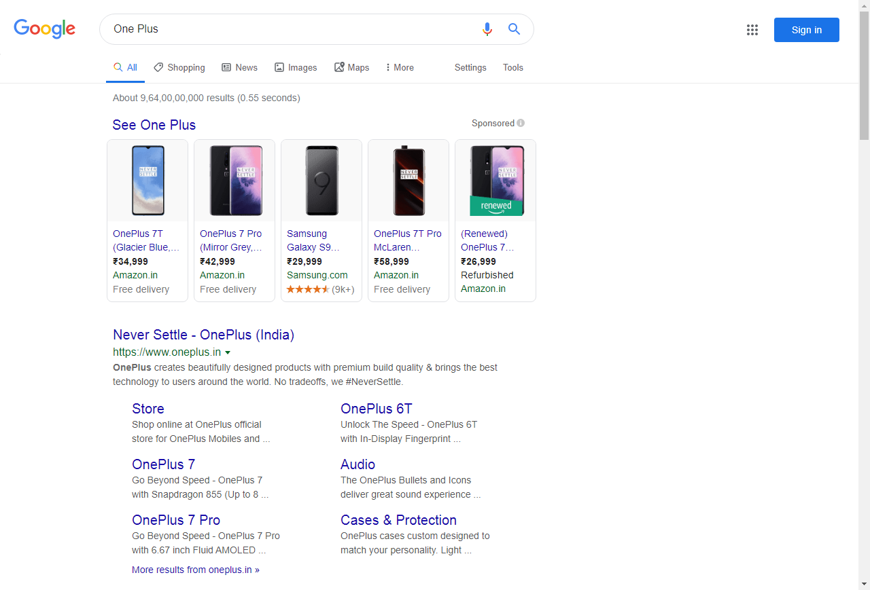
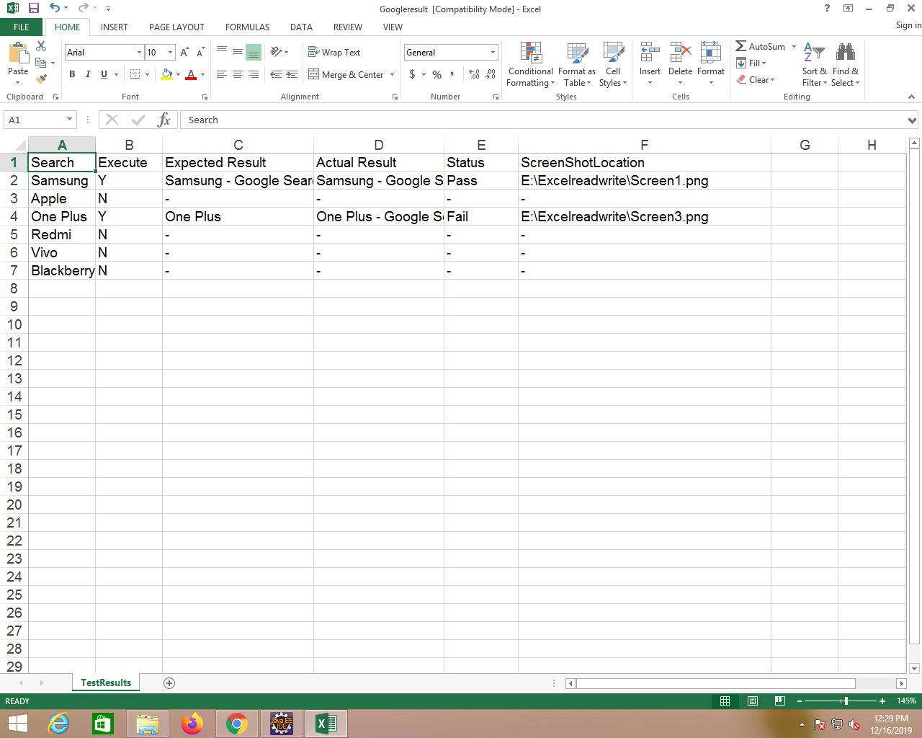
Search Result using Data Driven Framework(DDF)
Result-Google Search
Excel Sheet

Slide 21
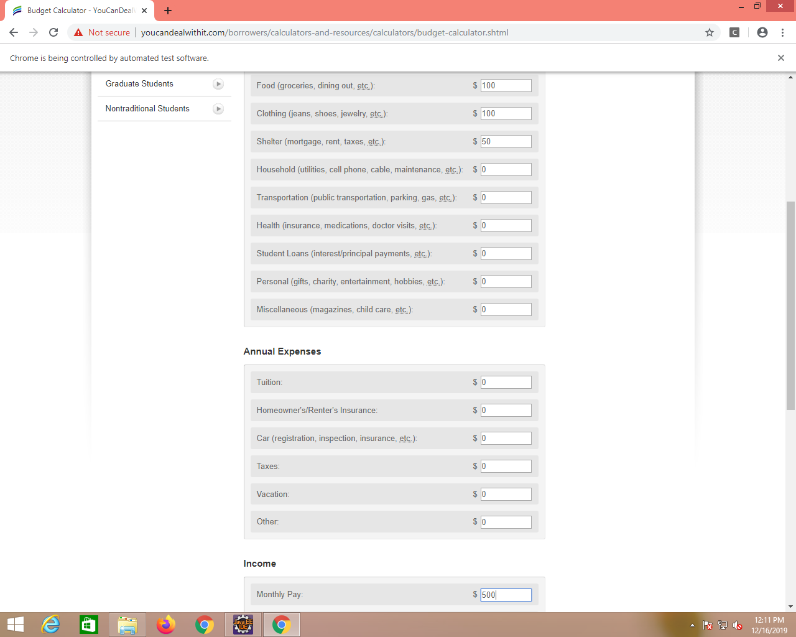
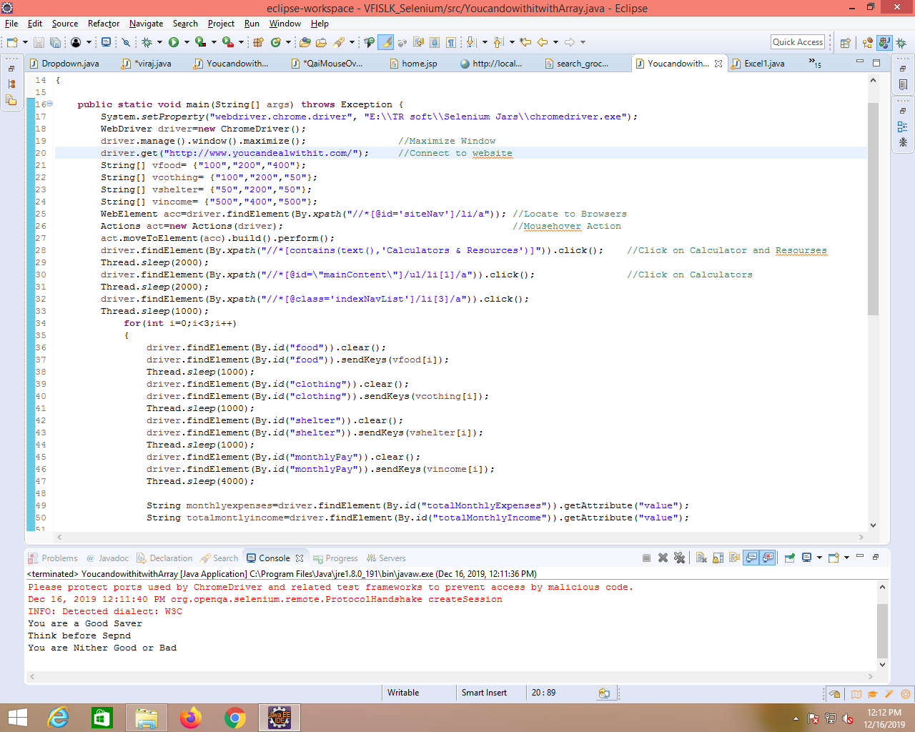
Budget Calculator– Case Study 2
Retrieving data from array, entering the data in budget calculator fields and displaying calculated results.
Code
Output

Slide 22
Source Code
https://github.com/akshaychavan97/TestAutomation
https://github.com/mayureshps/TestAutomation
https://github.com/ArpitaSarvi/TestAutomation
https://github.com/zabimd18/TestAutomation
https://github.com/Sandeep-174/TestAutomation

Slide 23
Thank You

